Slide 1
Leveraging AI in the Private Sector: Insights and Trends
A Data-Driven Analysis
Presented by: Jake Charney

Slide 2
Introduction
Objective: To provide a data-driven analysis of AI trends in the private sector, helping executives make informed decisions on AI investments and strategies.
Agenda:
Dataset Overview
Key Trends and Insights
Strategic Recommendations

Slide 3
Dataset Exploration
The Private Sector AI Indicators dataset from the Emerging Technology Observatory (ETO) provides detailed insights into the adoption and impact of AI across various industries. Key metrics include:
AI Spending: Investment amounts in AI technologies across sectors.
Implementation Rates: Percentage of companies implementing AI solutions.
AI-Driven Revenue Growth: Financial growth attributed to AI deployment.
Workforce Impact: Changes in employment due to AI, including job displacement and creation.
Regional Variations: Differences in AI adoption and impact by geographic location.
For more details, visit ETO's documentation.

Slide 4
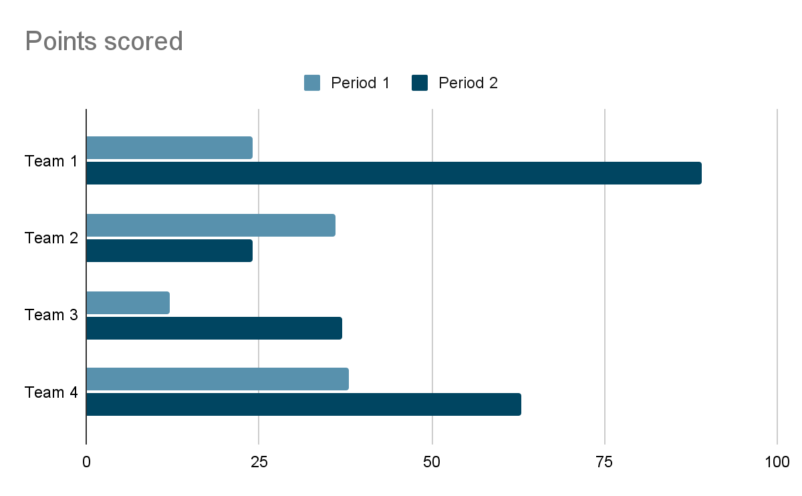
AI Spending by Industry
Visualization: Bar plot showing AI spending across different industries.
Insight:
Technology and Finance sectors lead in AI spending.
Healthcare and Manufacturing are emerging in AI adoption.

Slide 5
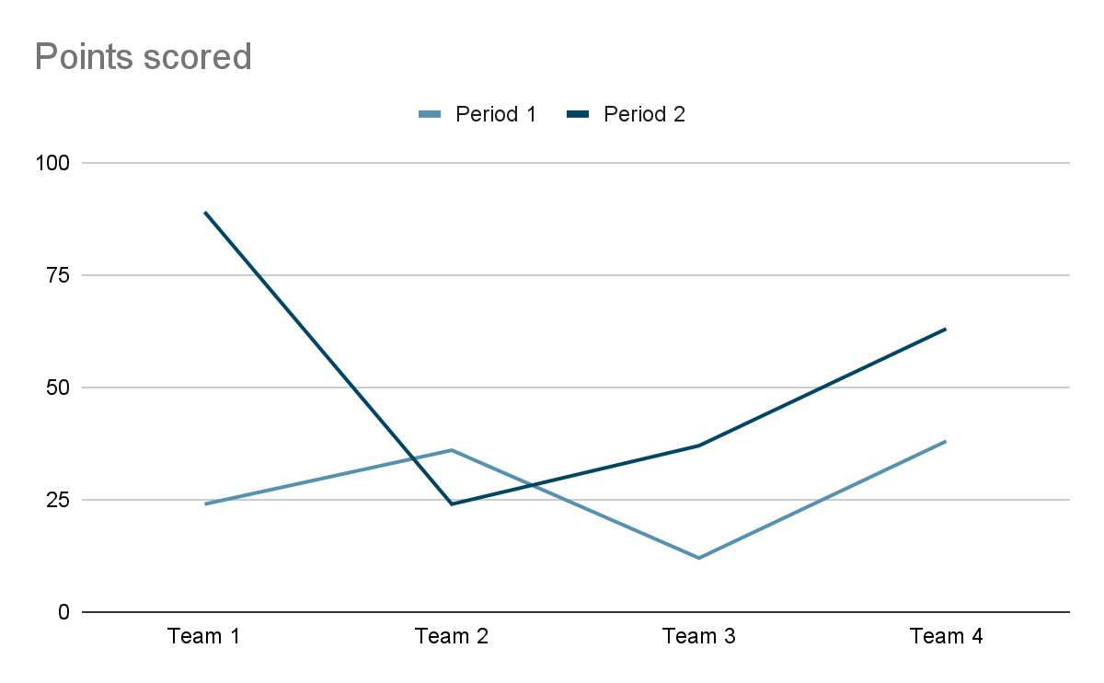
AI Implementation Rates
Visualization: Line graph showing the implementation rates of AI from 2015 to 2023.
Insight:
Steady increase in AI implementation across all sectors.
Significant uptick in the last 3 years, indicating accelerated adoption.

Slide 6
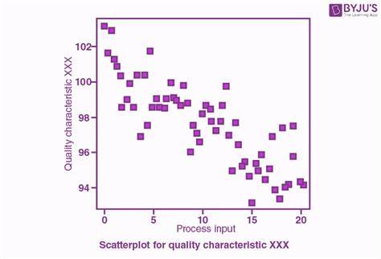
AI-Driven Revenue Growth
Visualization: Scatter plot comparing AI-driven revenue growth with AI spending.
Insight:
Positive correlation between AI spending and revenue growth.
High spending sectors like Tech and Finance see the most significant revenue increases.

Slide 7
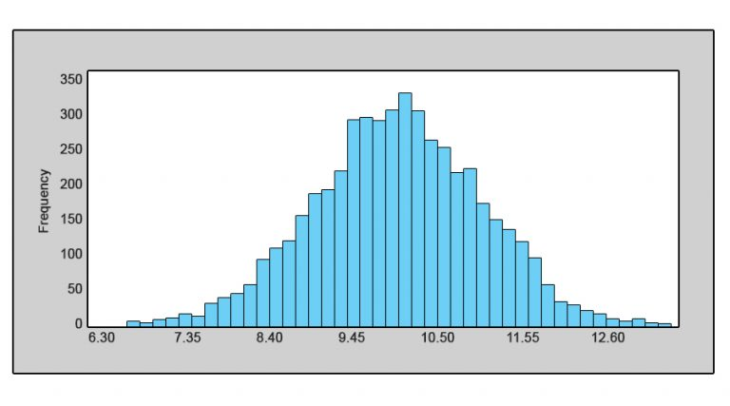
Workforce Impact
Visualization: Histogram showing the impact of AI on the workforce by job function.
Insight:
Automation is reducing roles in repetitive tasks.
Increase in demand for AI-specialized roles and upskilling initiatives.

Slide 8
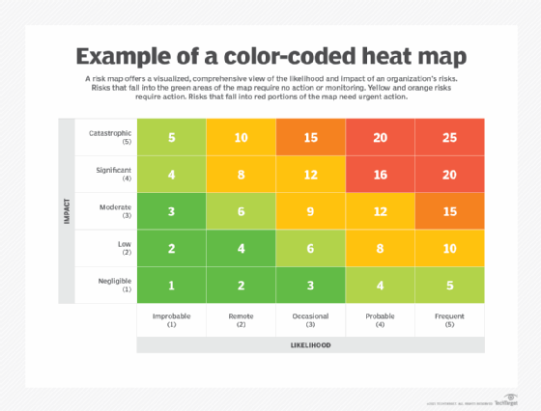
Regional Variations
Visualization: Heatmap showing regional variations in AI adoption.
Insight:
North America and Europe are leading in AI adoption.
Emerging markets in Asia are showing rapid growth.

Slide 9
Key Findings
Industry Leaders: Tech and Finance are at the forefront of AI adoption.
Accelerated Growth: Recent years show a significant increase in AI implementation rates.
Revenue Correlation: Higher AI spending is linked to substantial revenue growth.
Workforce Transformation: AI is reshaping the job market, with new roles emerging.

Slide 10

Strategic Recommendations
Invest in AI: Prioritize AI investment in high-impact areas to drive revenue growth.
Focus on Training: Develop upskilling programs to prepare the workforce for AI-driven roles.
Monitor Trends: Keep an eye on regional and industry-specific AI trends to stay competitive.
Leverage Data: Utilize data-driven insights to make informed strategic decisions.

Slide 11
AI is transforming the private sector, offering significant opportunities for growth and innovation.
By understanding and leveraging these trends, executives can position their organizations for success in the AI-driven future.

Slide 12

Thanks!
Contact us:
Your Company
123 Your Street
Your City, ST 12345
no_reply@example.com
www.example.com

